Slide 1



SignWeb – Enabling communication through AI sign language translation
Bridging the communication gap for effective communication between the speech and hearing impaired

Slide 2



Department of Information Technology
Title Finalization Seminar
Date : 24/02/2024
Session: 2023-2024 Group Number: - IT_C_11
Title of the Project:- SignWeb (Enabling communication through AI sign language translation)
Presented By:
Arpit Tamrakar (C_60)
Gaurav Barange (C_63)
Gunwant Sonkusare (C_64)
Aniket Nehare (C_70)
Guide
Prof. Pravin Jaronde Assistant Professor GHRCE , Nagpur

Slide 3

Project Description
Objective:
SignWeb is a groundbreaking web application designed to bridge communication gaps between the deaf and hearing communities by facilitating seamless translation between sign language and text. The app serves as a versatile tool for both deaf individuals who primarily communicate through sign language and hearing individuals who may not understand sign language but wish to communicate effectively with the deaf community.
Scope :
SignWeb revolutionizes communication accessibility by empowering users to express themselves fluently in both sign language and text. Through its innovative features and user-friendly interface, SignWeb aims to foster greater understanding, inclusivity, and connectivity between the deaf and hearing communities, thereby promoting a more inclusive society.

Slide 4

NEED OF THE PROJECT
Accessibility and Inclusivity: Many deaf individuals primarily use sign language as their primary means of communication. By providing a platform that can translate sign language to text, individuals who are not fluent in sign language can better understand and communicate with deaf individuals, thereby promoting inclusivity and accessibility in various contexts such as education, healthcare, and employment.
Communication with Hearing Individuals: Deaf individuals often face challenges in communicating with hearing individuals who may not understand sign language. A website that translates sign language to text enables smoother communication between deaf and hearing individuals, facilitating interactions in everyday life situations.
Education and Learning: For those learning sign language, a website offering text to sign translation can be a valuable resource. Learners can input text and receive corresponding sign language representations, aiding in their understanding and mastery of sign language vocabulary and grammar.
Remote Communication: In situations where face-to-face communication is not possible, such as during the COVID-19 pandemic or for individuals living in remote areas with limited access to sign language interpreters, a website for sign to text and text to sign translation provides an essential tool for remote communication and accessibility.

Slide 5
Literature Survey
Sr. No | Title of the paper | Year of publication | Remarks
1 | Sign Language to Text Conversion in Real Time using Transfer Learning | 2023 | the American Sign Language which will take actions in the form of ASL as input and translate it into text. To achieve the translation a Convolution Neural Network model and a transfer learning model based on the VGG16 architecture are used.
2 | Conversion of Sign Language to Text | 2022 | system is designed to enable deaf and mute people to communicate with others in a more accessible and convenient way. The proposed method uses computer vision and deep learning methods to recognize hand gestures and translate them into appropriate text.
3 | Machine translation from text to sign language: a systematic review | 2021 | An equal opportunity for all is the basic right of every human being. The deaf society of the world needs to have access to all the information just like hearing people do. For this to happen there should be a mode of direct communication between hearing and deaf people. The need at this time is to automate this communication so as the deaf society is not dependent upon human interpreters

Slide 6
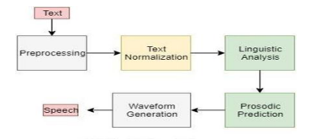
Methodology

Slide 7

Planning of Project Work:
Project Timeline:
Decided a timeline with key milestones and deadlines for each phase of development.
Milestones may include system design, AI model training, Speech Processing, UI connection.
Task Breakdown:
Break down project tasks into manageable components.
Assigned responsibilities and deadlines to team members for each task.
Tasks may include data collection, AI model development, , Speech Processing, UI connection.
Resource Allocation:
Allocated resources such as personnel, budget, and technology required for each task.
Ensure proper coordination and utilization of resources to meet project goals efficiently.

Slide 8
Platform & Technology used
Programming Language: Python, HTML, CSS, JS
IDE’s used: VSCode, jupyter, pycharm
Libraries used: opencv, tensorflow, numpy, Mediapipe, streamlit

Slide 9
A Signweb is a software application that translates sign language gestures or movements into written text. It typically involves capturing video of sign language gestures using a camera or sensor and then processing that input to recognize the specific signs being used. This recognition process may involve computer vision techniques, machine learning algorithms, or a combination of both. Once the signs are recognized, the converter converts them into written text, allowing individuals who are deaf or hard of hearing to communicate with those who do not understand sign language. On the other hand, a "text to sign" converter performs the opposite function. It takes written text input and translates it into sign language gestures or movements. This type of converter is useful for enabling communication between individuals who are deaf or hard of hearing and those who do not understand sign language. Similar to the sign to text converter, the text to sign converter may use technologies such as natural language processing and machine learning to understand the meaning of the text and generate corresponding sign language gestures. Both types of converters play important roles in facilitating communication and inclusivity for individuals who use sign language as their primary mode of communication. They can be implemented as standalone devices, mobile applications, or integrated into communication devices to assist in real-time communication both in person and remotely.
Description Of Concepts

Slide 10
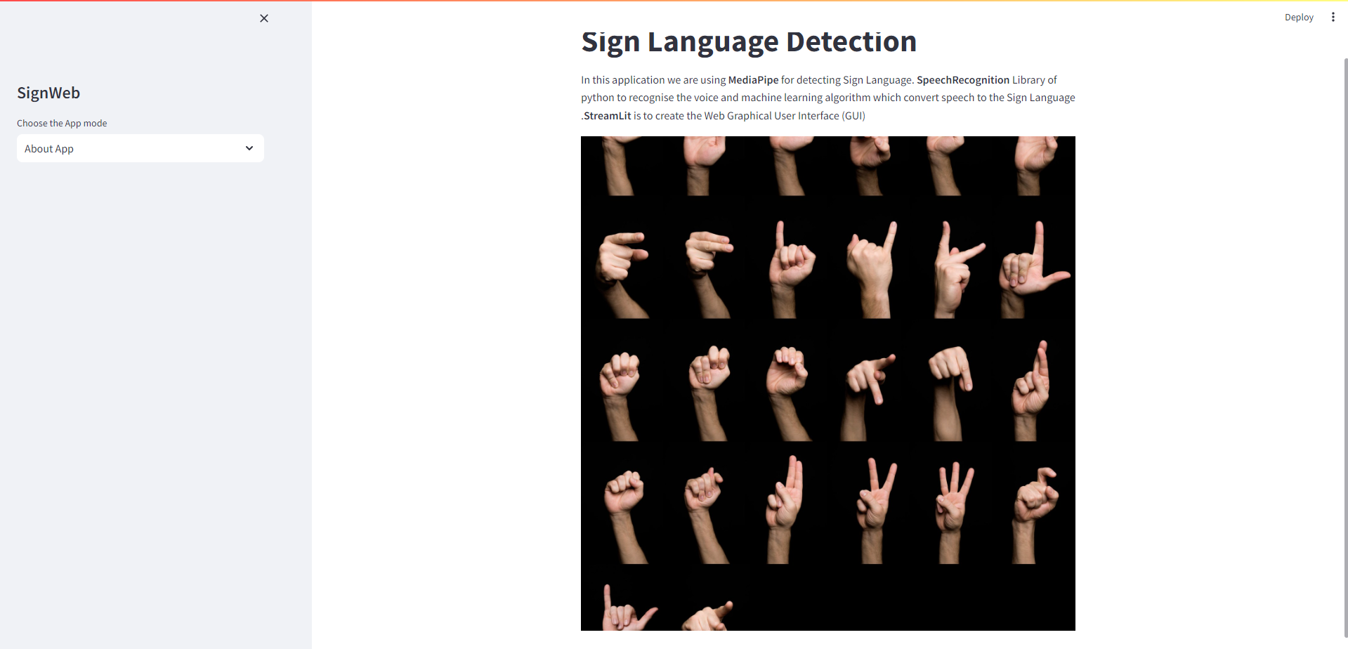
Result:

Slide 11
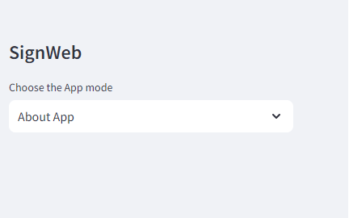
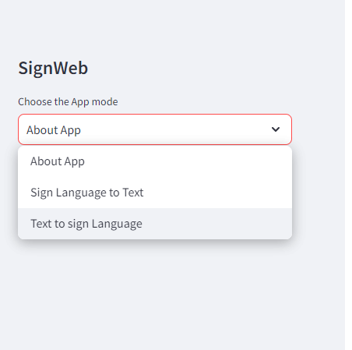
Project Work

Slide 12
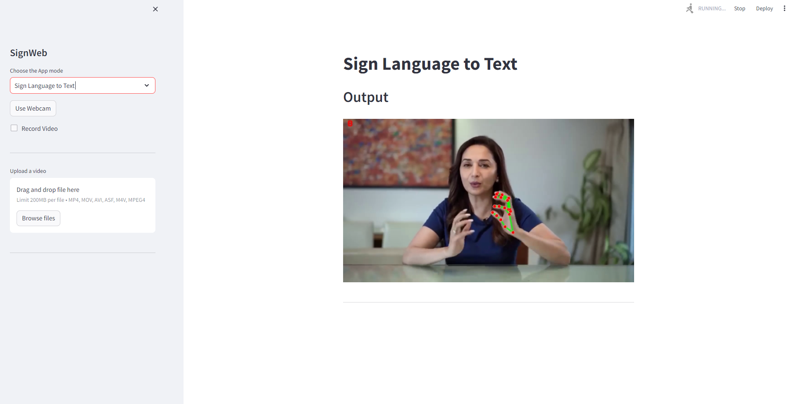
Project Work

Slide 13
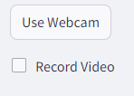
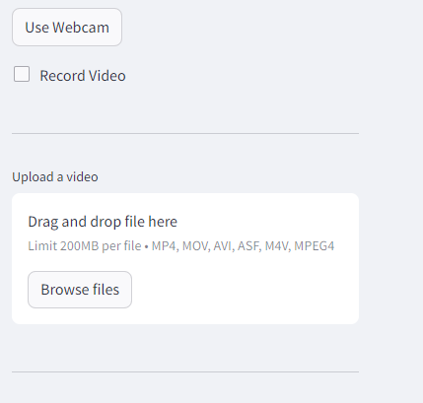
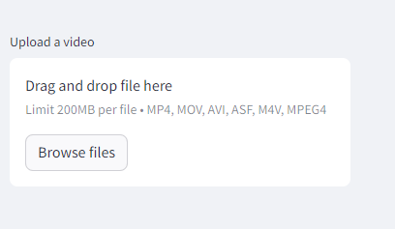
Features

Slide 14
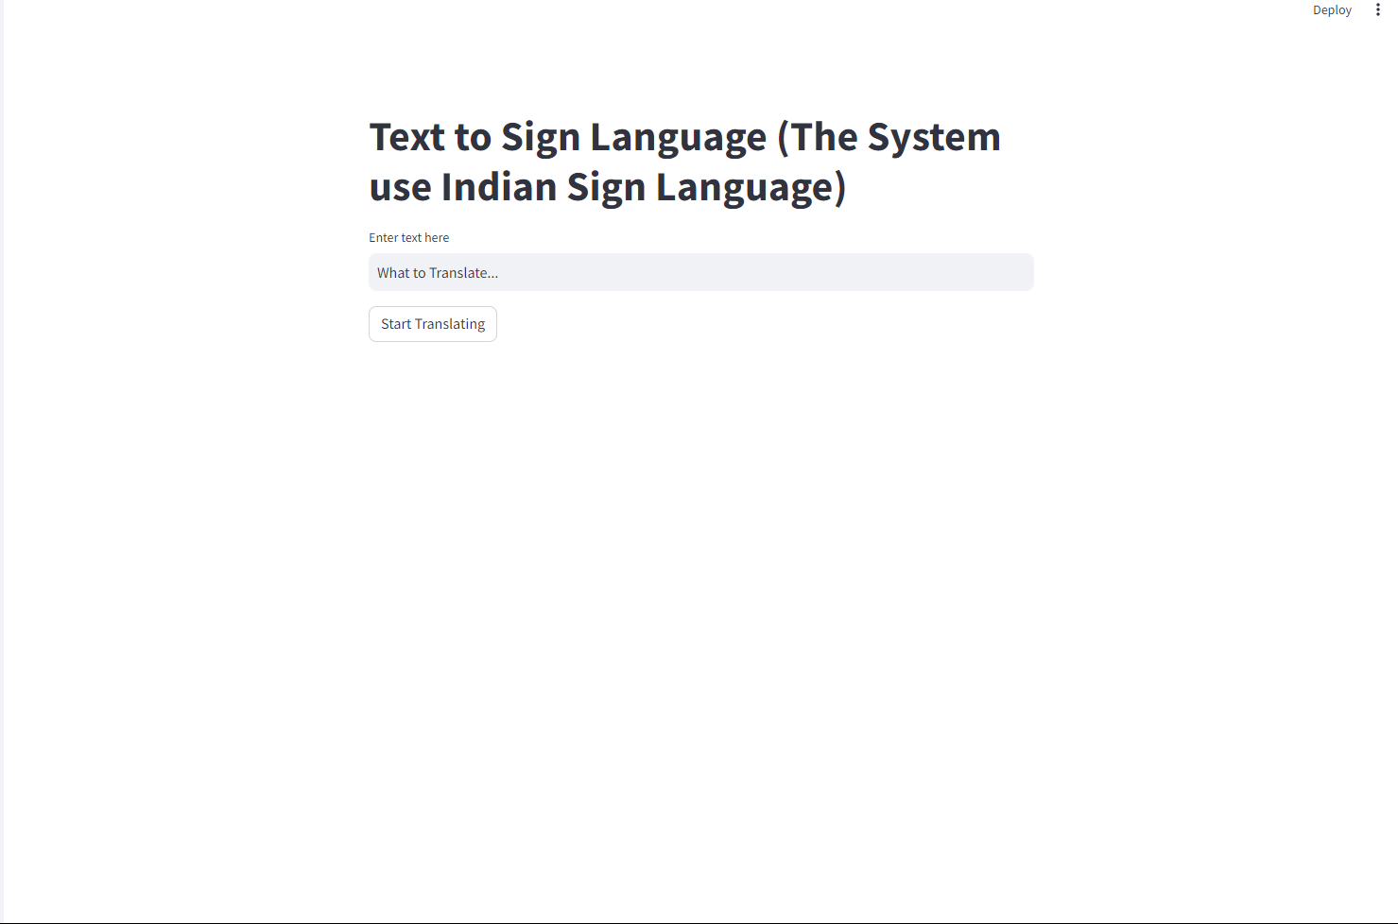
Project Work

Slide 15
Libraries used
Streamlit: Streamlit is a promising open-source Python library, which enables developers to build attractive user interfaces in no time. Streamlit is the easiest way especially for people with no front-end knowledge to put their code into a web application. Just copy and paste the needed code.
Mediapipe: MediaPipe is an open-source framework for building pipelines to perform computer vision inference over arbitrary sensory data such as video or audio. Using MediaPipe, such a perception pipeline can be built as a graph of modular components. MediaPipe is currently in alpha at v0.
Opencv: OpenCV-Python is a Python wrapper for the original OpenCV C++ implementation. OpenCV-Python makes use of Numpy, which is a highly optimized library for numerical operations with a MATLAB-style syntax. All the OpenCV array structures are converted to and from Numpy arrays.
Speech_recognition: Speech recognition is a machine's ability to listen to spoken words and identify them. You can then use speech recognition in Python to convert the spoken words into text, make a query or give a reply. You can even program some devices to respond to these spoken words
Numpy: NumPy is a Python library used for working with arrays. It also has functions for working in domain of linear algebra, fourier transform, and matrices.

Slide 16
1. Improved Accuracy: Enhancements in machine learning algorithms and data collection methods can lead to more accurate recognition and interpretation of sign language gestures. This would involve training models on larger and more diverse datasets to better understand the nuances of signing. 2. Real-Time Translation: Advancements in processing power and algorithm efficiency could enable real-time translation between sign language and text, allowing for seamless communication between signers and non-signers. 3. Gesture Recognition Devices: Development of specialized hardware devices, such as gloves or wearable sensors, could facilitate more accurate capture of sign language gestures, making the conversion process more precise and reliable. 4. Mobile Applications: Integration of sign-to-text and text-to-sign capabilities into mobile applications could greatly enhance accessibility for deaf and hard-of-hearing individuals in everyday communication scenarios, such as messaging and video calls. 5. Customization and Personalization: Tailoring the conversion process to individual users' signing styles and preferences could improve accuracy and user experience, similar to how voice recognition systems can be trained to recognize different accents and speech patterns.
Future Scope

Slide 17
References:
[1] Anuja V.Nair, Bindu.V, “A Review on Indian Sign Language Recognition”, International journal of computer applications, Vol. 73, pp: 22, (2013).
[2] Archana S. Ghotkar, Rucha Khatal, Sanjana Khupase, Surbhi Asati & Mithila Hadap, “Hand Gesture Recognition for Indian Sign Language”, IEEE International Conference on Computer Communication and Informatics (lCCCI), pp: 1-4, (2012).
[3] Hu Peng, “Application Research on Face Detection Technology based on Open CV in Mobile Augmented Reality”, International Journal of Signal Processing, Image Processing and Pattern Recognition, Vol. 8, No. 2 (2015).
[4] J. Rekha, J. Bhattacharya, and S. Majumder, “Shape, Texture and Local Movement Hand Gesture Features for Indian Sign Language Recognition”, IEEE 3rd International Conference on Trendz in Information Sciences & Computing (TISC2011), pp. 30-35, (2011).
[5] Meenakshi Panwar, “Hand Gesture Recognition based on Shape Parameters” International Conference on Computing, Communication and Application (ICCCA), pp: I-6, IEEE, (2012).
[6] Pravin R Futane, Rajiv V Dharaskar, “Hasta Mudra an interpretatoin of Indian sign hand gestures”, IEEE 3rd International Conference on Electronics Computer Technology, Vol.2, pp:377-380, (2011).
[7] Prof. Rajeshri Rahul Itkarkar, “A Study of Vision Based Hand Gesture Recognition for Human Machine Interaction”, International Journal of Innovative Research in Advanced Engineering, Vol. 1, pp:12, (2014).
[8] Rajam, P. Subha and Dr G Bala krishnan, "Real Time Indian Sign Language Recognition System to aid Deaf and Dumb people", 13thInternational Conference on Communication Technology (ICCT),pp. 737-742, (2011).

Slide 18

Thank You!

